Slide 1











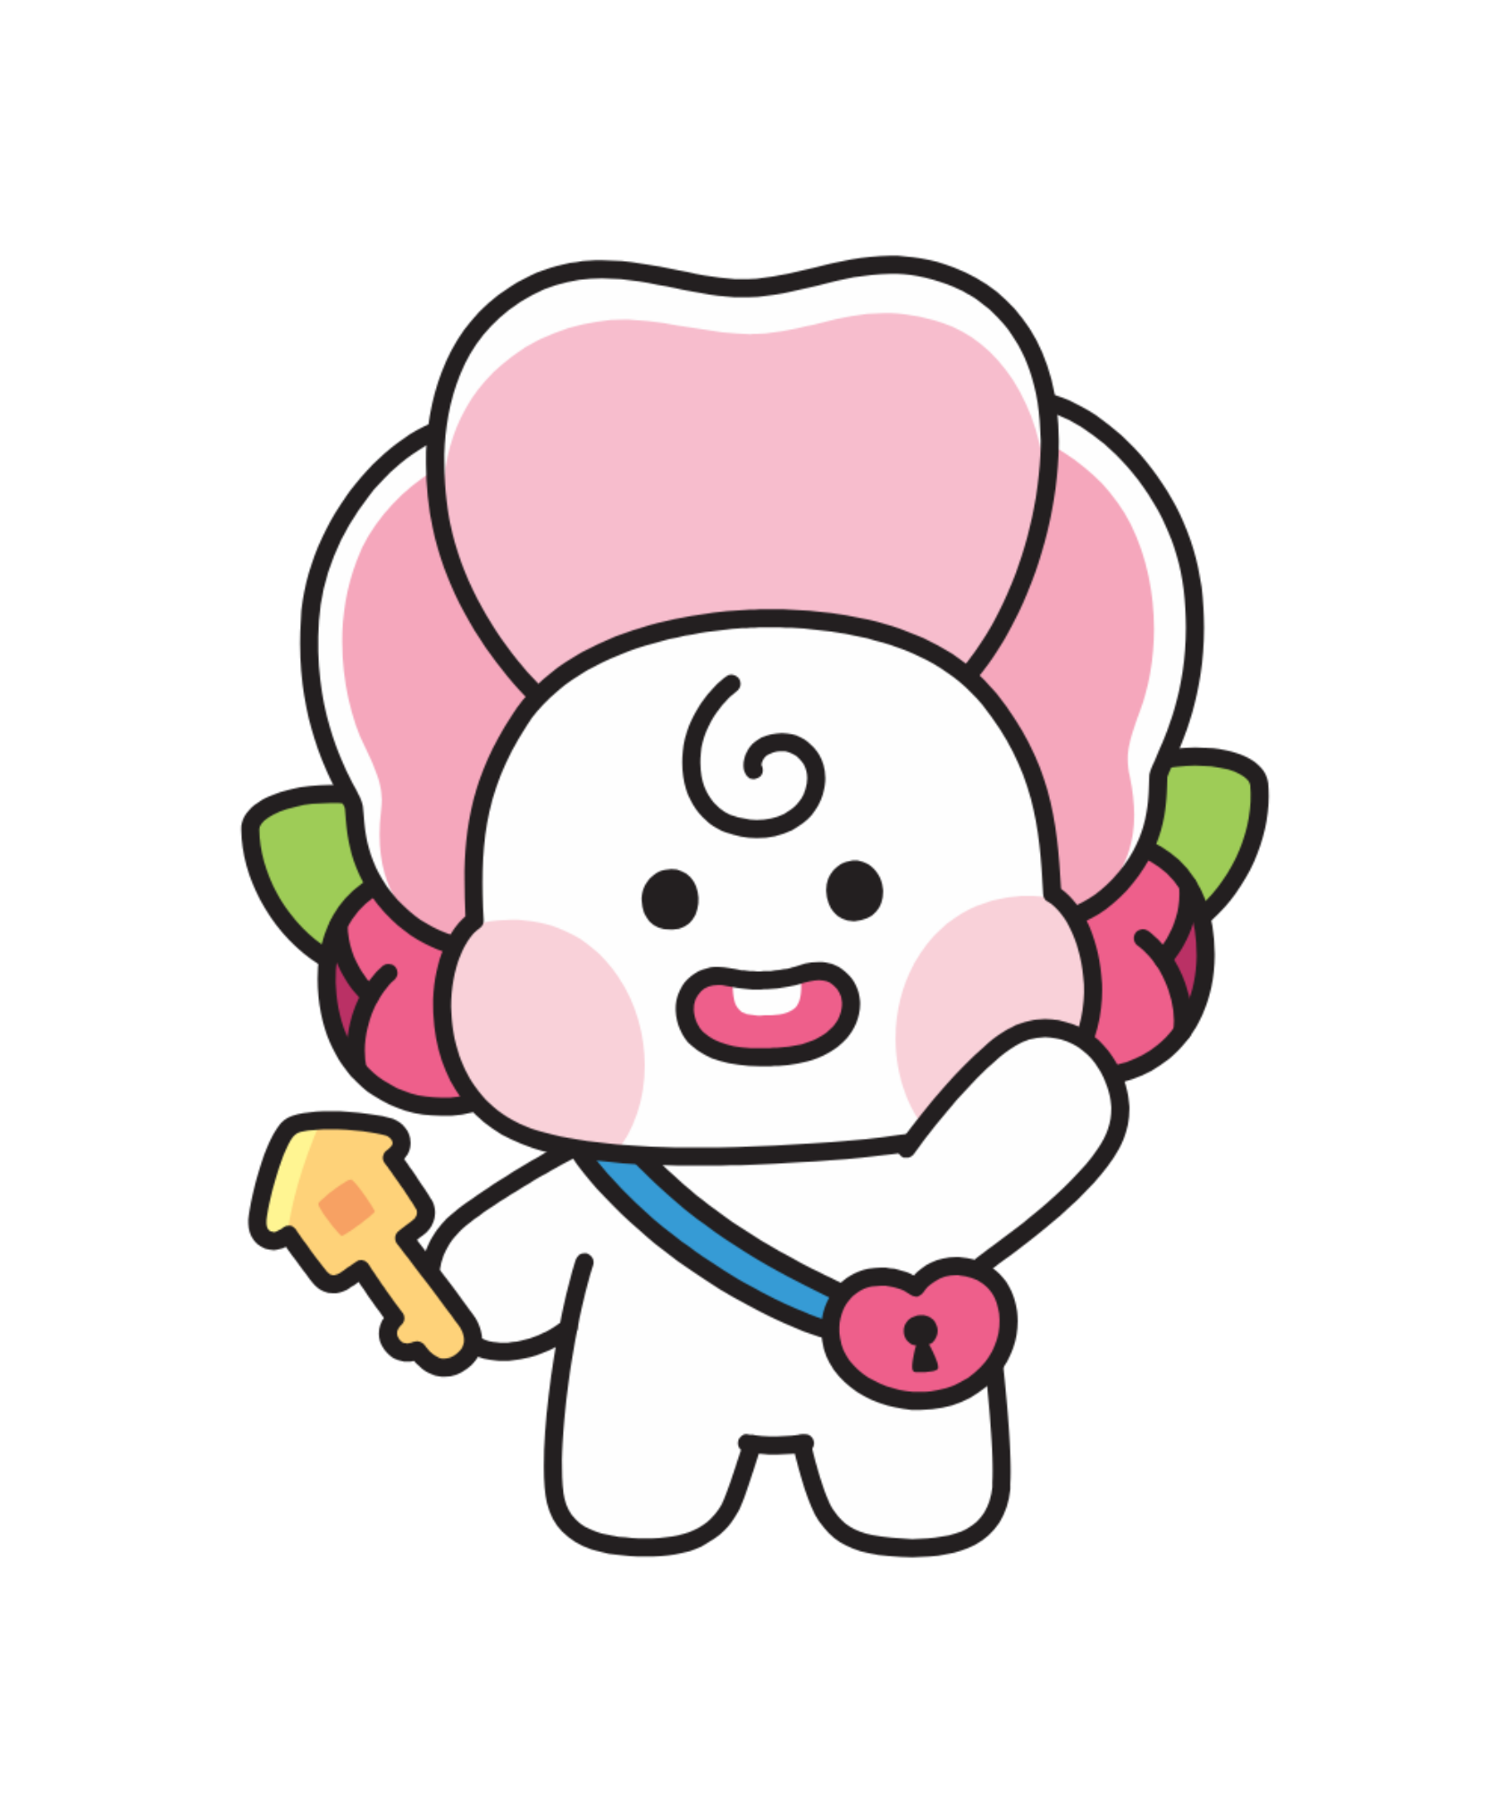


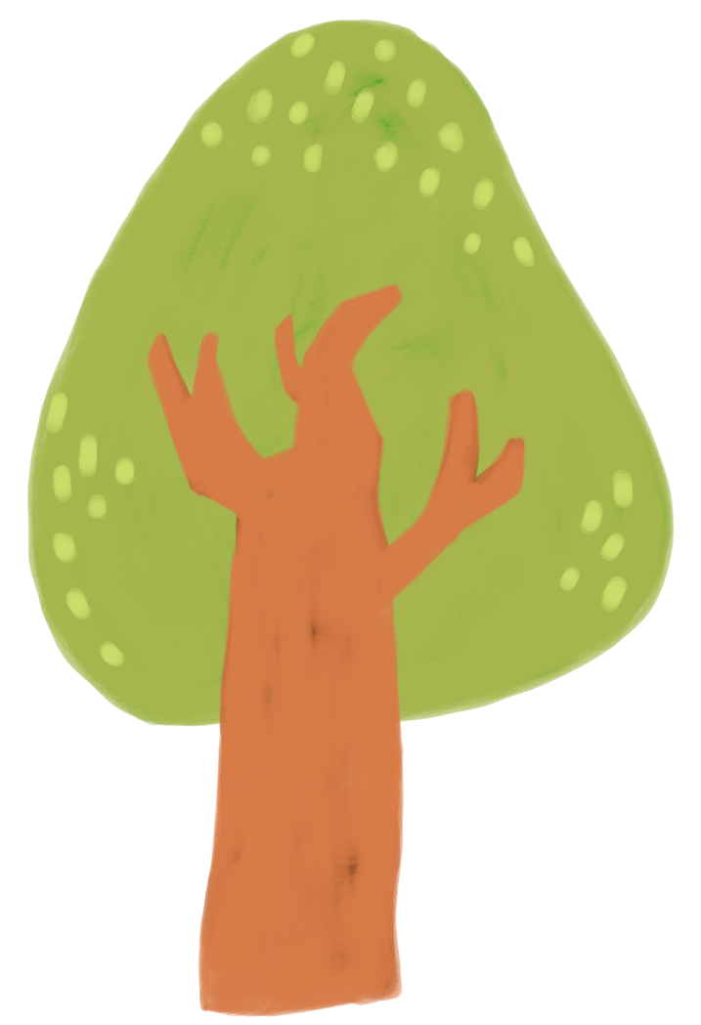



Warm April with Family
SEOCHOGU
FAMILY CENTER
April Program Information

Slide 2





Bangbae Headquarters
Family Love Day
Ordinary Family
Family Gardening Program
Daily Life - Deviation Package 2
Date & time : 4/17(Thu) 19:00~21:00
Location : Bangbae Headquarters 4th floor
training room
Recipient : Seocho-gu family
Content : Family Gardening Program
Inquiry : 070-7477-2406(Haeun Seo)
Date & time : 4/25(Fri) 19:00~21:00
Location : Bangbae Headquarters 4th
floor training room
Recipient : 7 single-parent/grand-parent
families, 15 people
Content : Organize storage training
Inquiry : 070-7477-2612(Joohyun Lee)
Whole Family Care Project
Happy Bridge
Psychological and Emotional Specialization
Council: Hope (Holding Hope)
‘Meeting; Meet the Inner
Side of Family’
Date & time : 4/25(Thu) 14:00~18:00
Location : Bangbae Headquarters 4th floor
training room
Recipient : Case manager of related
organizations in Seocho-gu
Content : Education related to borderline
intellectual disability
Inquiry : 070-7477-2412(Youngok Nam)
Date & time : Every tuesday 19:00~21:00
Location : Bangbae Headquarters 4th
floor open space
Recipient : Seocho-gu family
Content : Finding out your family’s heart
through art and food therapy
Inquiry : 070-7456-2415(Ye-seung Jeong)

Slide 3


Bangbae Headquarters
Support for growth of multicultural families
Global Aura Chamber
Global Ensemble
Date & time : Every tuesday, wednesday,
thursday15:00~20:00
※ Time varies by day
Location : Bangbae Headquarters 4th
floor open space
Recipient : 15 multicultural children
Content : Flute, Violin, Cello l:l Lessons
Inquiry : 070-7477-2404(Seulgi Park)
Date & time : Every Thursday
10:00~11:30 15:00~16:00
Location : Bangbae Headquarters 4th floor open space
Recipient : 5 multicultural parents
Content : Flute, Violin, Cello l:l Lessons
Inquiry : 070-7477-2404(Seulgi Park)
Korean Class (Children
Korean for children
(school age)
Korean for children (preschool)
Date & time : Every tuesday 16:00~17:00
Location : Bangbae Headquarters 4th
training room
Recipient : Multicultural children
Content : Customized Korean language
class for children
Inquiry : 070-7456-2415(Ye-seung Jeong)
Date & time : Every thursday 16:00~17:00
Location : Bangbae Headquarters 4th training room
Recipient : Multicultural children
Content : Customized Korean language
class for children
Inquiry : 070-7456-2415(Ye-seung Jeong)

Slide 4


Bangbae Headquarters
Korean Class (Adult)
Beginner Korean for adults
Intermediate Korean
for adults
Date & time : Every tuesday & thursday
10:00~12:00
Location : ZOOM
Recipient : Married immigrants, foreigners,
international students, etc.
Content : Beginner Korean Class
Date & time : Every monday & wednesday
10:00~12:00
Location : ZOOM
Recipient : Married immigrants, foreigners,
international students, etc
Content : Intermediate Korean Class
Topik for adults
Korean Conversation
for adults
Date & time: Every tue & thu 10:00~12:30
Location : ZOOM
Recipient : Married immigrants, foreigners,
international students, etc.
Content : Korean Topik Class
Date & time : Every tue & thu 13:30~15:30
Location : ZOOM
Recipient : Married immigrants, foreigners,
international students, etc.
Content : Korean Conversation Class
Inquiry : 070-7456-2415(Ye-seung Jeong)

Slide 5

External(outside)
Activities
Together Program
Family Volunteer Group
Seocho! Let’s go to Vietnam
Seocho Family Happy Plogging
Date & time : 4/12(Sat) 11:00~16:00
Location : Seocho Art and Culture Park
Recipient : 100 multicultural and non-
multicultural families living in Seocho-gu
Content : Vietnamese folk games with squid
game theme
Inquiry : 070-7436-2012(Yuna Kim)
Date & time : 4/19(Sat) 10:30~12:00
Location : Slow Road Course
Recipient : Family Volunteer
Content : Environmental beautification of
our neighborhood for families
Inquiry : 02-6919-9747(Soo-Kyung Kim)
Whole Family Care Project
Dahana (Seocho, all together as one)
Education and Culture: Our Family History Exploration Team
Cultural understanding education and awareness improvement puppet show for each country
Date & time : 4/26(Sat) 10:00~12:00
Location : Seoul Museum of History
Recipient : Vulnerable/at-risk case
families, 10 families, 20 people
Content : Trip to the Seoul Museum
of History
Inquiry : 070-7477-2408(Jinah Kim)
Date & time : Varies depending on institution
Location : Daycare centers, kindergartens,
elementary schools, etc.
Recipient : Children, teachers, etc., from
the applicant institution
Content : Multicultural understanding
education & puppet show
Inquiry : 070-7477-2406(Haeun Seo)

Slide 6




External(outside) Activities
Ready to Seocho
Seocho Child Care Project
Seocho Hair Salon
1st Conservative Education
Date & time: Every Mon & Fri 10:00~12:30
Location: Mega study Beauty Academy Gangnam Campus Building 2
Recipient : Married immigrants
Content : Hair & Beauty National
Certification Preparatory Course
Inquiry : 070-7456-2415(Ye-seung Jeong)
Date &time : 4/26(Sat) 10:00~12:00
Location : Korea Association of Property
Appraisers Main Hall
Recipient : Seocho Child rearers·119
Child-rearers
Content : Ongoing training for child-rearers
Inquiry : 070-7461-9764(Lee Geurim)
Family Counseling
(Center 1)
Ongoing Counseling
Counselor Supervision
Date & time : 4/8(Tue) 9:30~12:30
Location : ZOOM
Recipient : Appointed counselor at Seocho-gu
Family Center
Content : Strengthening counselor capacity
through counseling supervision
Inquiry : 070-7436-2422(Heejoo Noh)

Slide 7



Joint Childcare SharingCenter(Center 2)
Seocho Healing Daddy
Seocho Trend Daddy
Dads Climbing the Wall
Parenting Dad, Happy Family
Date & time : 4/23(Wed) 19:00-21:00
Location : Indoor climbing within Seocho-gu
Recipient : Male child rearers living in
Seocho-gu
Content : Indoor climbing activities
Inquiry : 02-6919-9750(Geunjoong Lee)
Date & time : 4/17(Thu) 19:30-21:00
Location : Seocho-gu Joint Childcare
Sharing Center
Recipient : Father living in Seocho-gu on childcare leave
(including planned leave)
Content : Participation in childcare, mental care,
division of household chores
Inquiry : 02-6919-9750(Geunjoong Lee)
Bilingual education support project
Bilingual Parent Family Coaching
“We are ECO Pirates”
Bilingual Direct Learning
“Two Languages, Double the Happiness Vietnamese”
Date & time : Every monday & wednesday
16:00-18:00 (2 weeks)
Location : Seocho-gu Joint Childcare Sharing
Center Lecture Room
Recipient : Multicultural Family Parents-
Children
Content : Earth Day learning and upcycling
experience
Inquiry : 070-7436-2013(Mallin)
Date & time : 4/1 ~ 12/12 every Tuesday 17:00~17:40)
Location : Seocho-gu Joint Childcare Sharing
Center Lecture Room
Recipient : Multicultural Family Children (Vietnam)
Content : Creating a bilingual environment Vietnamese basic class
Inquiry : 070-7436-2013(Mallin)

Slide 8



Joint Childcare SharingCenter(Center 2)
·
Seoul Family School
Child-rearers Permanent Program
Family Chef
' Little happiness gifted to myself '
"Flower One Day Class"
Date & time : 4/3(Thu)16:00~18:00
Location : Banpo 1-dong Community Daycare
Center
Recipient : Family living in Seoul
Content : Family communication activity &
cooking activity
Inquiry : 02-6919-9760 (Ha-eun Park)
Date & time : Every Wednesday 10:30~12:00
※ 4/30 (Wed) Time change: 19:30~21:00
Location : Seocho-gu Joint Childcare
Sharing Center lecture room
Recipient : Child-rearers living in Seocho-gu
Content : Making flower baskets , bouquets & writing letters
Inquiry : 02-6919-9748(Da-Seul Kim)
Seocho Friend Daddy
Rearers-Child Permanent Program
One more step in the forest with dad
Let's take care of the Earth!
Date & time : 4/19(Sat) * Time TBD
Location : Forest experience area in Seocho-gu
Recipient : Male child-rearers & children living in Seocho-gu
Content : Forest experience activities with dad
Inquiry : 02-6919-9750(Geunjoong Lee)
Date & time : 4/4,4/11(Fri) 17:30~18:30
4/18, 4/25(Fri) 19:30~20:30
Location : Joint childcare sharing center play
space/classroom
Recipient : Child-rearers and children
living in Seocho-gu
Content : Upcycling education and crafting
Inquiry : 02-6919-9748(Da-Seul Kim)

Slide 9




Seocho Eomma Healing Center
(Center 3)
F(Family)-DAY
Parent-Child Recipient
Date & time : 4/16(Wed) ) * Time TBD
Location : Seocho Eomma Healing Center
Recipient : Parents and children in Seocho-gu
Content : Parent-Child Programs
Inquiry : 02-573-2010(Yeseul Moon)
Multicultural family growth support
Global Aura Chamber
Date & time : Every Wednesday 14:30-19:00
Location : Seocho Eomma Healing Center
Recipient : 5 multicultural children and 1 adult Content : Violin, Viola 1:1 Lessons
Inquiry : 070-7477-2404(Seulgi Park)

Slide 10

Seocho Eomma Healing Center
(Center 3)
M(Mommy)-DAY
Bite of World Travel
Aesthetics of Knots
Mom's Hand Recipe
Date & time : 4/9(Wed) 10:30~12:30
Recipient : Mother living in Seocho-gu
Content : World Cuisine Program
Date & time : 4/14(Mon) 10:30~12:30
Recipient : Mother living in Seocho-gu
Content : Craft Program
Date & time : 4/23(Wed) 10:30~12:30
Recipient : Mother living in Seocho-gu Content : Making healthy food for kids
P(parents)-DAY
D(Daddy)-Day
Waldorf Parenting Education
Program for Dads
Date & time : Every Tuesday 10:30~12:30
Recipient : Parents living in Seocho-gu
Content : Waldorf Parenting Education
Date & time : 4/19 10:00~12:00
Recipient : Father living in Seocho-gu
Content : Program for Dads
Location :
Seocho Eomma Healing Center
Inquiry :
070-7436-2011(Hojin Cho)

Slide 11

Permanent Program Recruitment Information
Program name | Program | Recipient | Content | Application Method | Inquiry (Person in Charge)
Korean Class | Korean for Adult | Marriage immigrants, foreigners, international students, etc. | Beginner class, intermediate class, Topik class, conversation class | After applying by phone Submit Google Form | 070-7456-2415 (Ye-seung Jeong)
 | Korean for Children | Multicultural children | Korean for children ages 6-8
Dahan | Multicultural understanding education, puppet show to improve multicultural awareness | Institutions (kindergartens, elementary schools, etc.) | Cultural understanding education and puppet shows by country |  | 070-7477-2406 (Haeun Seo)
Multicultural Family Children’s Language Development Support Project | Language Development Support Project | Children of multicultural families under 12 years old | Language assessment, language facilitation education, parent counseling and education | Phone call or visit the center | 070-7436-2423 (Mijin Heo)
Marriage Immigrant Interpretation and Translation Service Support | Interpretation and Translation Service Support | Interpreting, translation, and information provision | Multicultural families, foreigners, refugee families, related organizations, etc. | Phone call, visit the center, or email | 070-7436-2012 (Yuna Kim)
Ongoing counseling | Family Counseling Support Project | Individual, family, couples counseling | Anyone who wants counseling | Phone call | 070-7477-2410 (Jeongeum Kim)

Slide 12


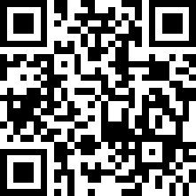
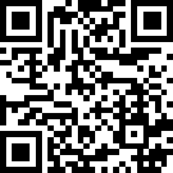

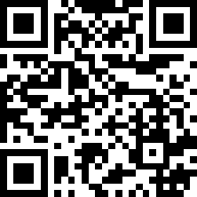
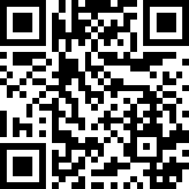
Are you interested in information
about the Seocho-gu Family Center?
seochohfsc
seochohfsc_1
Seocho-gu Family Center (Headquarters)
: Family education, family culture, child care
▷ Operation on Weekdays 9:00~18:00
※ Closed on weekends and public holidays
10-20 Bangbae-ro 10-gil, Seocho
District, Seoul, 4-5 flr.
Yangjae Counseling Center (Center 1)
: Counseling/language development center for Seocho-gu families
Operation on Weekdays 9:00~20:00
※ Closed on weekends and public holidays
Located on the 2nd floor of Seocho Cultural Arts Center
☎02-576-2852
☎070-7477-2410
seochohfsc_2
seochohfsc_3
Joint Childcare Sharing Center ( Center 2)
: Place for Rearers and children in Seocho-gu
Operating from 9:00 to 18:00 on weekdays
※ Monday to Saturday)
Location on the 2nd floor of Pamies Station
Seocho Eomma's Healing Center (Center 3)
: Relaxation/cultural area for mothers
and families.
Operation on Weekdays 9:00~18:00
※ (Closed on weekends and public holidays)
Located on the 3rd floor of Naegok SH Plaza
☎02-6919-9748
☎02-573-2010

Slide 13



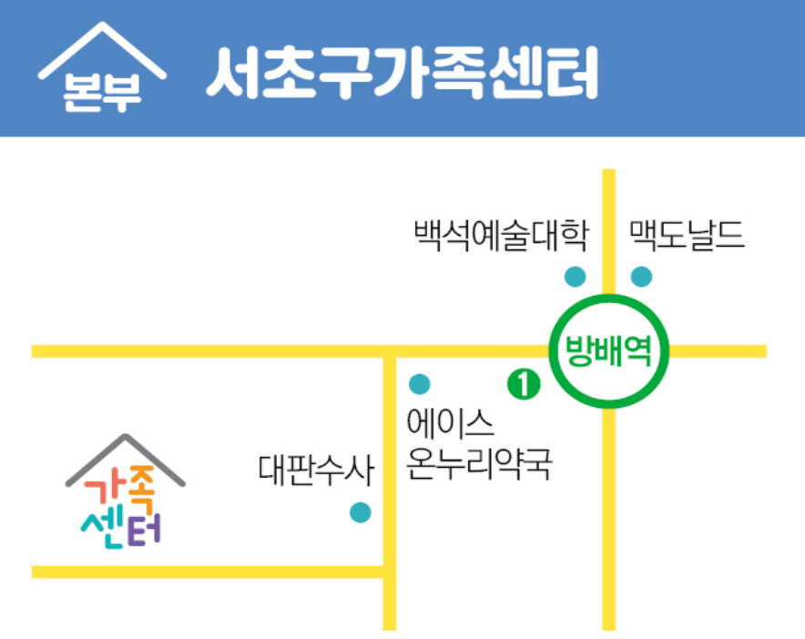
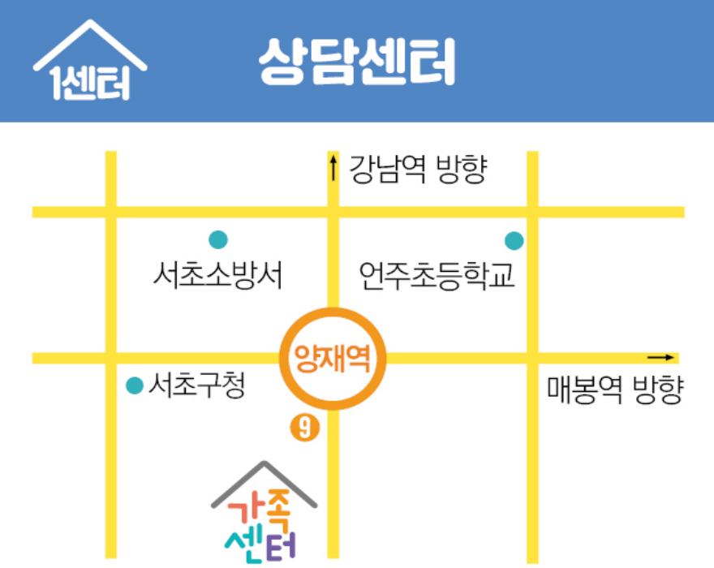
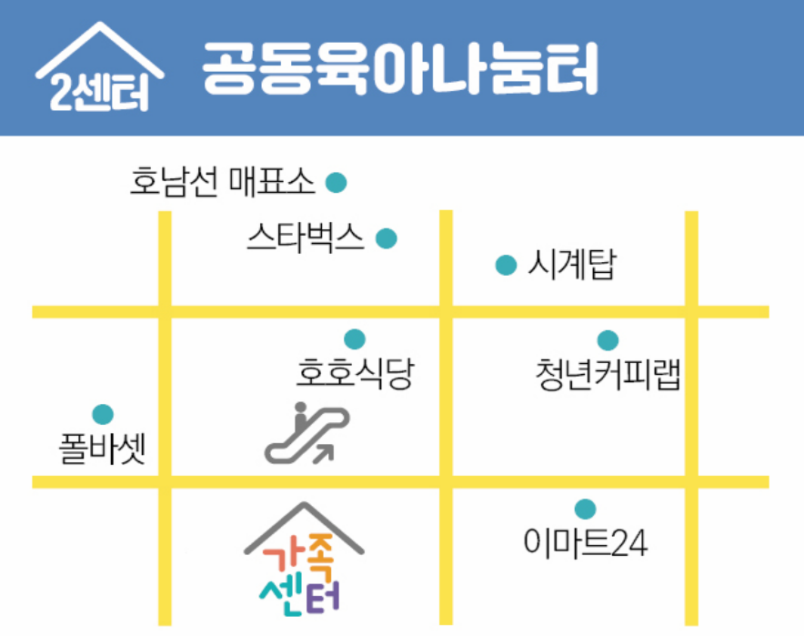
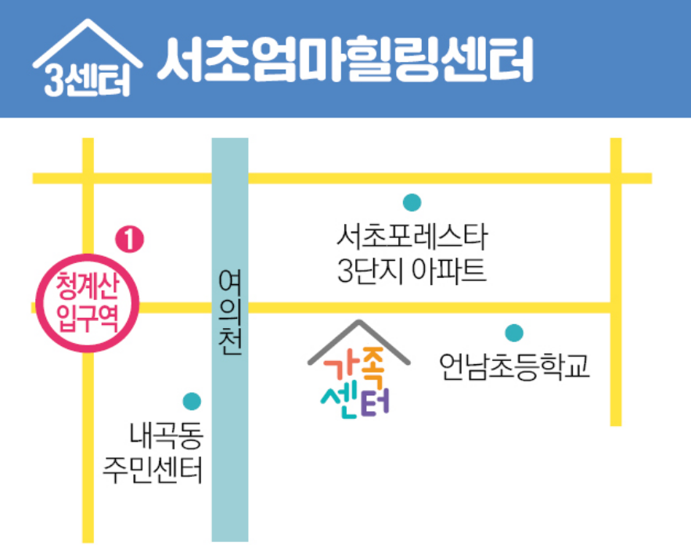
Directions to
Seochogu Family Center
Bangbae Headquarters
Center 1
방
배
본
부
1
센터
Line 2 Bangbae Station Exit 1(Ace Onnuri Pharmacy, alleway left) Seocho Family Center, 4-5 Flr.
Line 3 or Shinbundang LineYangjae Station Exit 9
Seocho Cultural Arts Center 2nd flr.
Center 2
Center 3
2
센터
3
센터
Line 3,7,9 Express Bus Terminal Station 2nd flr. of Pamies Station
”Seocho-gu Rearing Open Sharing Center”
Shinbundang Line Cheonggyesan Entrance Station 15 minutes walk from Exit 13rd flr. of Naegok SH Plaza
'Eomma's Healing Center''

Slide 14


April, when Warm Spring
Breezes Blow
Together with Family
A warm breeze blows and the green leaves turn green,
and a new April has begun.
In the month of April, which is full of the scent of spring, programs that will help families grow together and become stronger will be held. Let's make family memories with Seochogu Family Center~
" Happiness for all families in Seocho-gu,
We are together!"

